Slide 1
Probability Theory

Slide 2

Probability
Relative frequency:
  Let us toss a coin and observe its outcomes:
  {H,H,T,H,T,T,T,T,H,H,H,T,T,H,T,T,H,H,H,T,T,H,H,H}
        Number of heads:13=frequency of head
        Number of tails: 11 =frequency of tail
        Relative frequency of H=number of H/total number of tosses=13/24=0.5417
        Relative frequency of T= number of T/total number of tosses=11/24=0.4583
  Note that Relative frequency of H + Relative frequency of T=1
  If number of tosses-> Infinity, we get probability

Slide 3
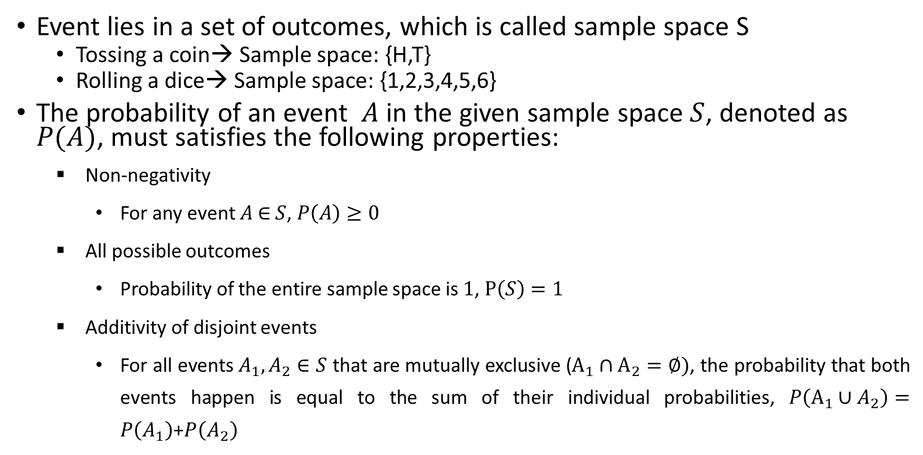
Event
Event lies in a set of outcomes, which is called sample space S
  Tossing a coin→ Sample space: {H,T}
  Rolling a dice→ Sample space: {1,2,3,4,5,6}
The probability of an event $A$ in the given sample space $S$, denoted as $P(A)$, must satisfies the following properties:
  Non-negativity
    For any event $A$ ∈ $S$, $P\left(A\right)≥0$
  All possible outcomes
    Probability of the entire sample space is $1$, $P\left(S\right)=1$
  Additivity of disjoint events
    For all events $A_{1},A_{2}∈S$ that are mutually exclusive ($A_{1}∩A_{2}=∅)$, the probability that both events happen is equal to the sum of their individual probabilities, $P\left(A_{1}∪A_{2}\right)=P\left(A_{1}\right)$+$P\left(A_{2}\right)$

Slide 4
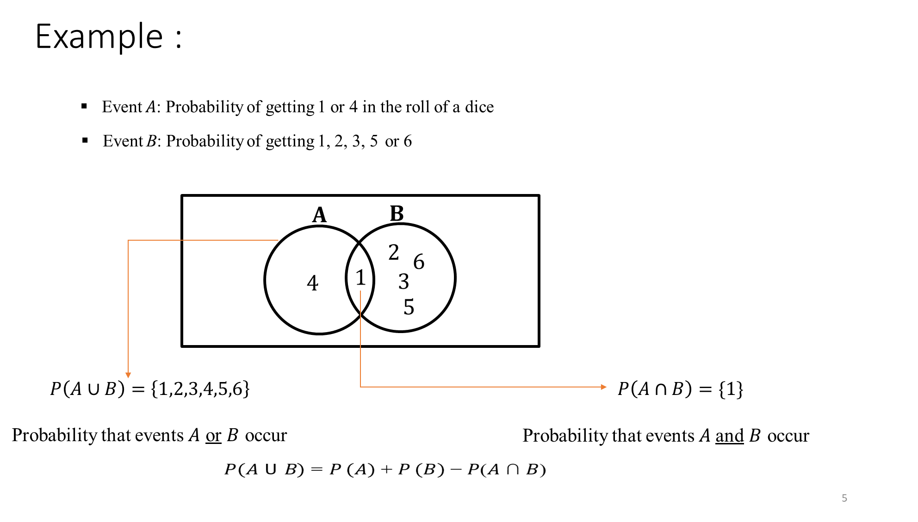
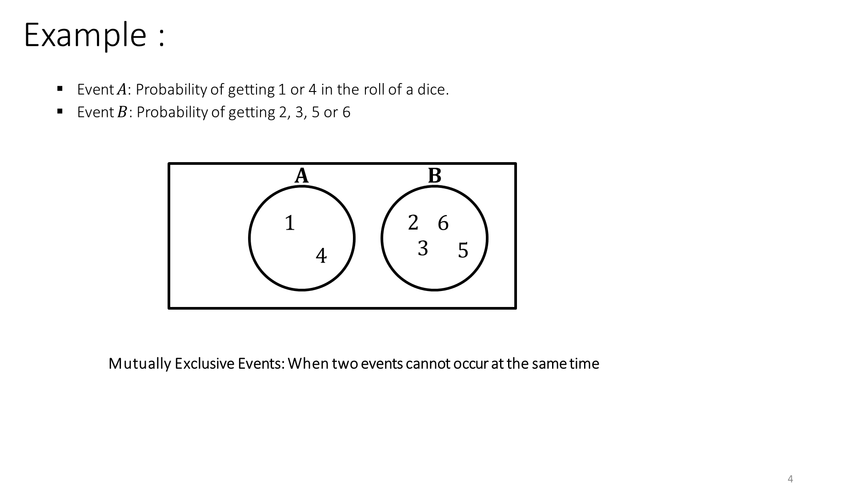

Slide 5
Independent Events
Events A and B are independent, if
P(A|B)=P(A)
P(B|A)=P(B)
P(A|B) is the conditional probability of A given B has occurred
Example: Let us toss a coin (Event A) and roll a dice (Event B) together, what is the probability of getting H when 5 occurs on dice?
P(H|5)=P(H): does not depend upon the dice outcome
Similarly,
P(5|H)=P(5): does not depend upon the coin outcome

Slide 6
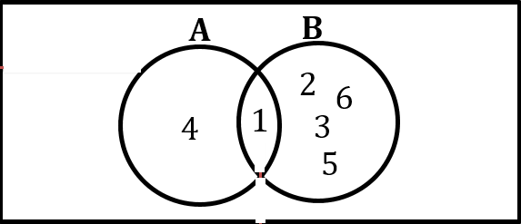
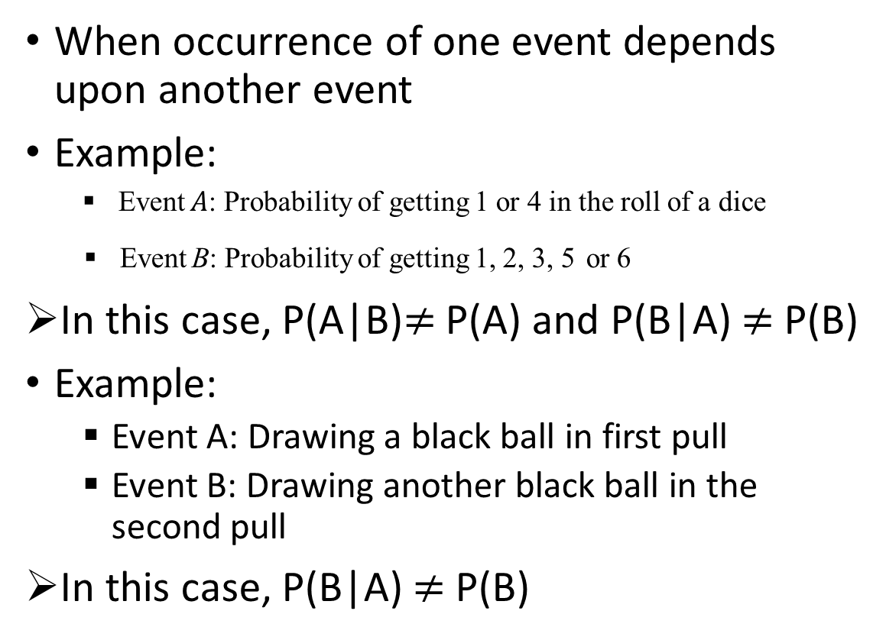
Dependent Events
When occurrence of one event depends upon another event
Example:
  Event $A$: Probability of getting 1 or 4 in the roll of a dice
Event B: Probability of getting 1, 2, 3, 5 or 6
In this case, P(A|B)$≠$ P(A) and P(B|A) $≠$P(B)
Example:
  Event A: Drawing a black ball in first pull
  Event B: Drawing another black ball in the second pull
In this case, P(B|A) $≠$P(B)

Slide 7
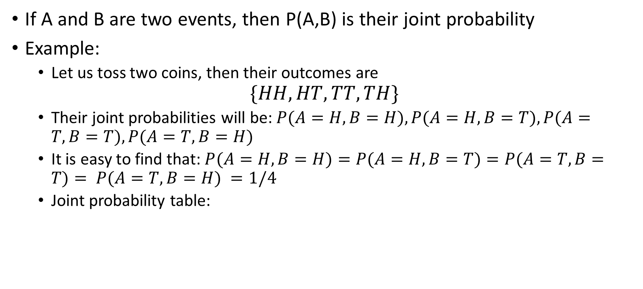
Joint Probability
If A and B are two events, then P(A,B) is their joint probability
Example:
  Let us toss two coins, then their outcomes are
$$\{HH,HT,TT,TH\}$$
  Their joint probabilities will be: $P(A=H,B=H), P(A=H,B=T), P(A=T,B=T), P(A=T,B=H)$
  It is easy to find that: $P(A=H,B=H)=P(A=H,B=T)=P(A=T,B=T)= P(A=T,B=H) =1/4$
  Joint probability table:
A/B | H | T
H | 1/4 | 1/4
T | 1/4 | 1/4

Slide 8
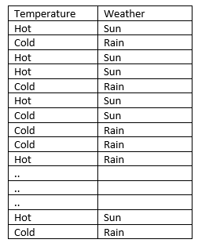
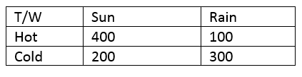

Example
A table recording Temperature and Weather of a location
  Temperature {Hot, Cold}
  Weather {Sun, Rain}
Suppose there are 1000 entries, a pairwise summary
Joint probability

Slide 9

Bayes’ Rule
$$P\left(A | B\right)=\frac{P\left(A,B\right)}{P\left(B\right)}$$
$$\underset{⇒}{}P\left(A,B\right)=P\left(A | B\right).P\left(B\right)$$
If A and B are independent: $P\left(A | B\right)=P(A)$
$$P\left(A,B\right)=P(A).P\left(B\right)$$

Slide 10
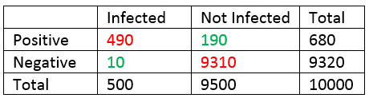
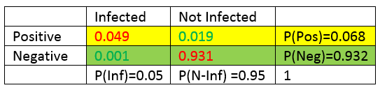
Application of Bayes’ Rule: COVID-19 Testing
A COVID-19 test kit offers very high test accuracy of 98% (490*100/500)
Frequency Table
Joint Probability

Slide 11
Application of Bayes’ Rule: COVID-19 Testing
What are the chances that a person tested positive is actually infected
P(Inf|Pos)=P(Pos, Inf)/P(Pos)
P(Inf|Pos)=0.049/0.0680=0.72
A positive result from test, then there is only a 72% chance of infected. This indicates a 28% people who test positive but not infected leading to quarantining.
Similarly, P(Not-Inf|Pos), P(Inf|Neg), etc. can be calculated.

Slide 12
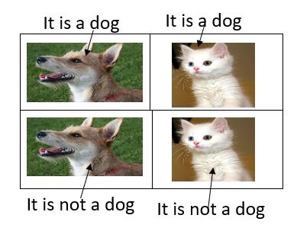
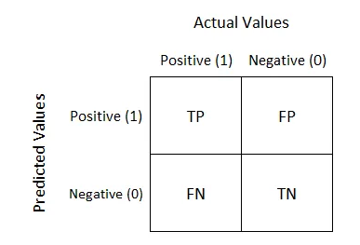




Confusion Matrix
True Positives (TP): The number of positive cases that were correctly predicted as positive.
True Negatives (TN): The number of negative cases that were correctly predicted as negative.
False Positives (FP): The number of negative cases that were incorrectly predicted as positive.
False Negatives (FN): The number of positive cases that were incorrectly predicted as negative.
Accuracy: The percentage of correct predictions made by the model.
Precision: The percentage of positive predictions that were correct.
Recall: The percentage of actual positive cases that were correctly identified by the model.
F1-score: The harmonic mean of precision and recall.
Accuracy$=\frac{TP+TN}{TP+TN+FP+FN}$
Precision$=\frac{TP}{TP+FP}$
Recall$=\frac{TP}{TP+FN}$
F1 Score$=2× \frac{\text{Precision}×Recall }{\text{Precision}+Recall}$

Slide 13

Confusion Matrix Calculations
Recall=TP/(TP+FN)=490/500=0.98
Precision=TP/(TP+FP)=490/680=0.72
Accuracy=TP+TN/Total=(490+9310)/10000
=0.98
F-measure=2*Recall*Precision/(Recall+Precision)
=2*0.98*0.72/(0.98+0.72)
=0.83
TP
FP
FN
TN

Slide 14

Confusion Matrix Example
Consider a scenario where you have developed a model to classify emails as either spam (positive) or not spam (negative). To evaluate the performance of this model, you test it on a dataset containing 100 emails. The results of this test are used to illustrate how a confusion matrix works.
Accuracy$=\frac{40+45}{40+10+45+5}=0.85$ or $85\%$
Actual\Predicted | Spam (P) | Not Spam (N)
Spam (P) | 40 | 5
Not Spam (N) | 10 | 45
Precision$=\frac{40}{40+10}=0.8$ or $80\%$
Recall$=\frac{40}{40+5}=0.89$ or $89\%$
F1 Score$=2× \frac{\text{0.8}×0.89 }{\text{0.8}+0.89}=0.84$ or $84\%$

Slide 15
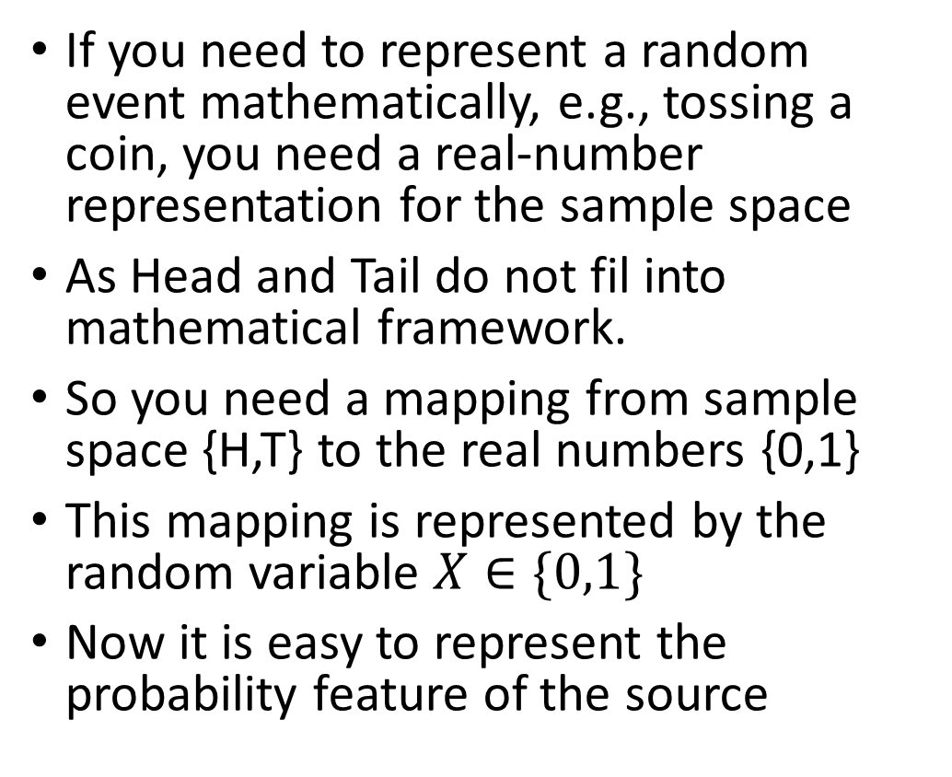
Random Variable
If you need to represent a random event mathematically, e.g., tossing a coin, you need a real-number representation for the sample space
As Head and Tail do not fil into mathematical framework.
So you need a mapping from sample space {H,T} to the real numbers {0,1}
This mapping is represented by the random variable $X∈\{0,1\}$
Now it is easy to represent the probability feature of the source
Sample space
Random variable X
Real-numbers
1/2
1/2
P(X)
0
1
X

Slide 16
Discrete RV
Discrete random variables have countable number of outcomes
Examples:
  Tossing of coin
  Rolling a dice
  Disease testing (Infected/Non-infected)
  Horse race
  Waiting time
  Arrival time
  Weather forecast
  Chance of success/failure
  Random choice from a given set

Slide 17
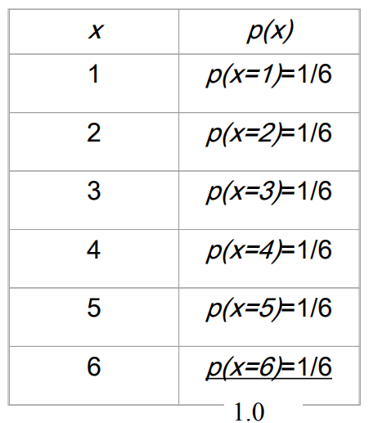
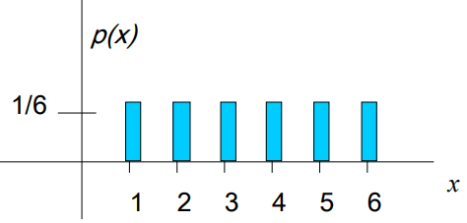
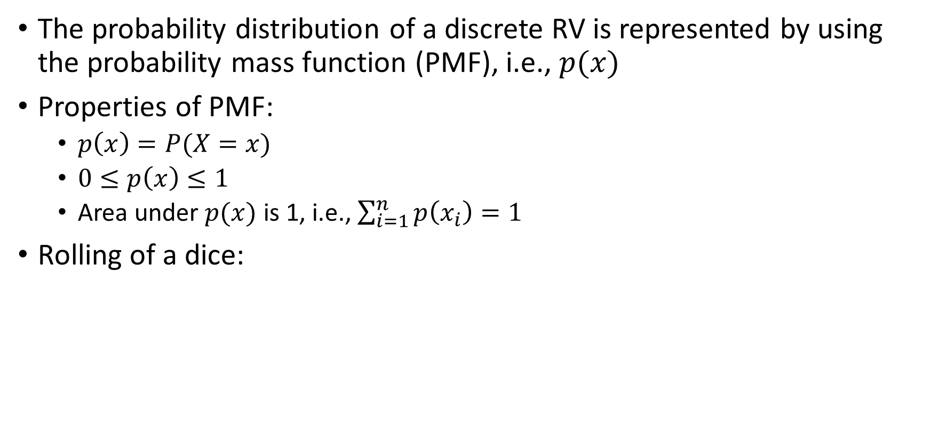
PMF
The probability distribution of a discrete RV is represented by using the probability mass function (PMF), i.e., $p(x)$
Properties of PMF:
  $p\left(x\right)=P(X=x)$
  $0≤p\left(x\right)≤1$
  Area under $p(x)$ is 1, i.e., $\sum_{i=1}^{n}{p\left(x_{i}\right)=1}$
Rolling of a dice:

Slide 18
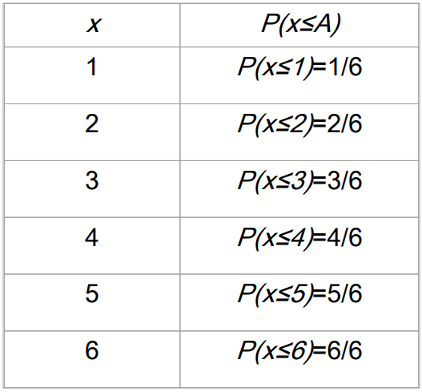
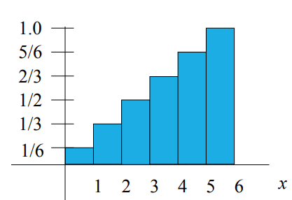


CDF
CDF stands for cumulative distribution function
Representation: $F_{X}\left(x\right)=P(X≤x)$
Rolling of a dice:
$$F_{X}\left(x\right)$$

Slide 19
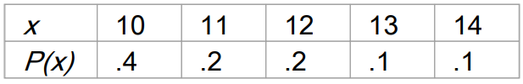
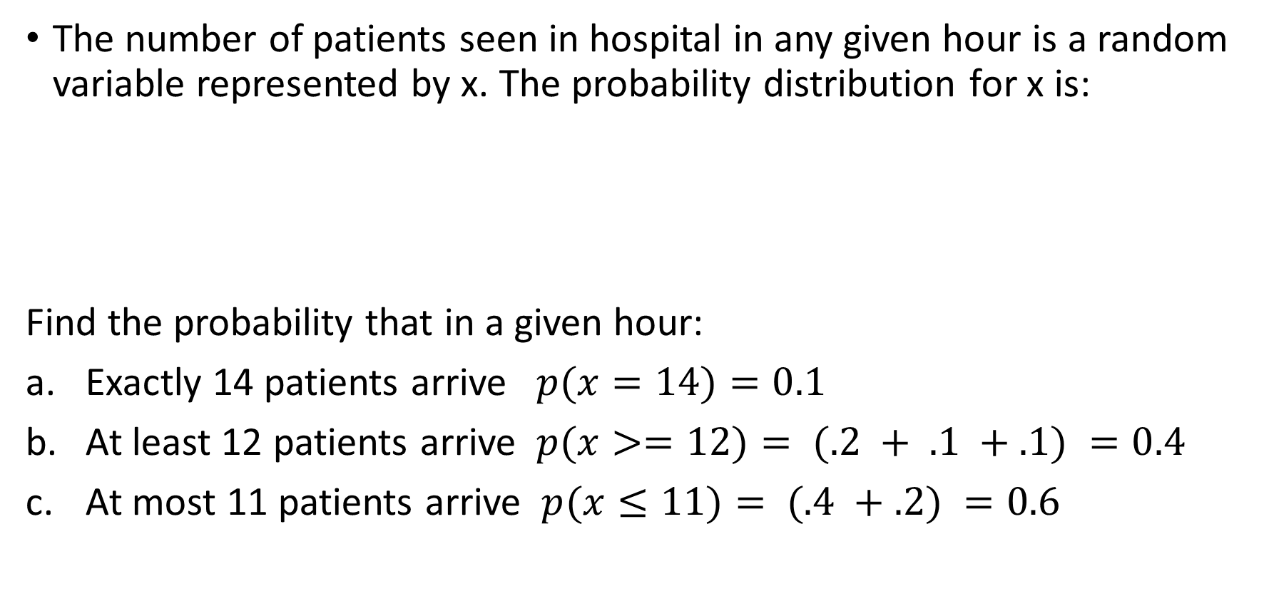
Practice Problem
The number of patients seen in hospital in any given hour is a random variable represented by x. The probability distribution for x is:
Find the probability that in a given hour:
Exactly 14 patients arrive $p(x=14)=0.1$
At least 12 patients arrive $p(x>=12)= (.2 + .1 +.1) =0.4$
At most 11 patients arrive $p(x≤11)= (.4 +.2) =0.6$

Slide 20
Discrete Probability Distributions
Bernoulli Distribution
  Single trial of success/failure
  Flipping a coin
  Disease testing (positive/negative)
Binomial Distribution
  Flipping a coin n number of times and calculating the probabilities of getting a particular number of heads
  Number of successful sales calls for a company; out of n calls
  Whether a drug works for a disease or not; tried for n patients
Poisson Distribution
  Average number of calls per hour in a call center
  Waiting time in a queue
  Arrival time

Slide 21
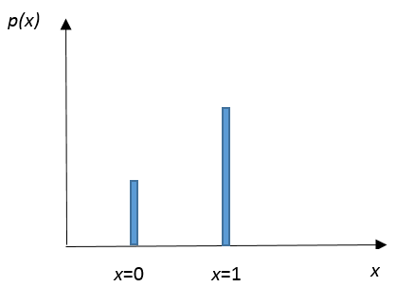
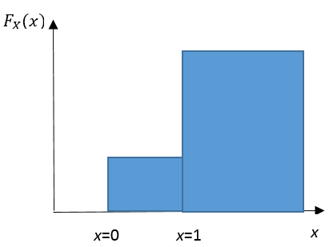
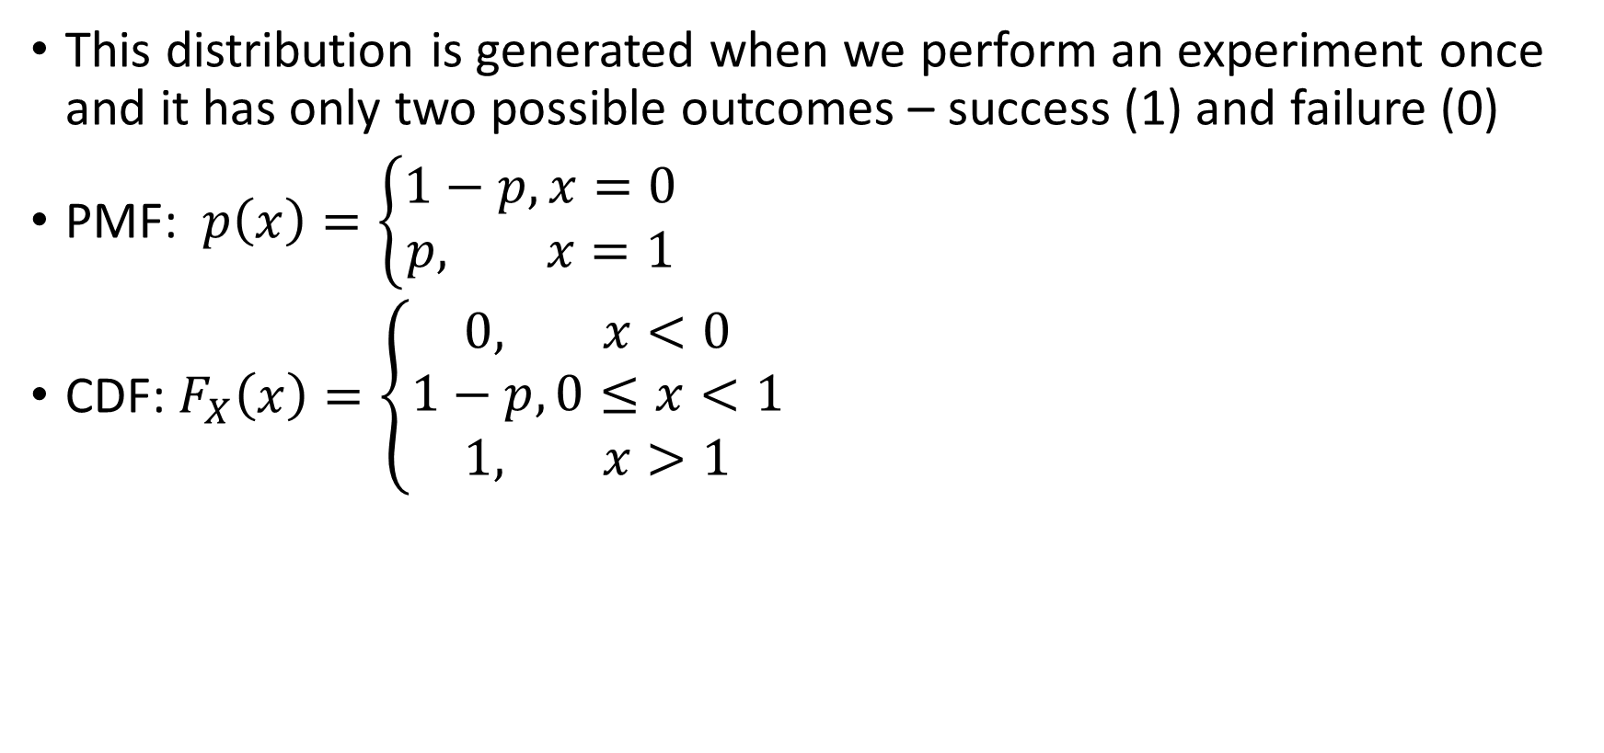
Bernoulli Distribution
This distribution is generated when we perform an experiment once and it has only two possible outcomes – success (1) and failure (0)
PMF: $p\left(x\right)=\left\{\begin{matrix}1−p, x=0 \\ p, x=1\end{matrix}\right.$
CDF: $F_{X}\left(x\right)=\left\{\begin{matrix}0, x<0 \\ 1−p, 0≤x<1 \\ 1, x>1\end{matrix}\right.$

Slide 22
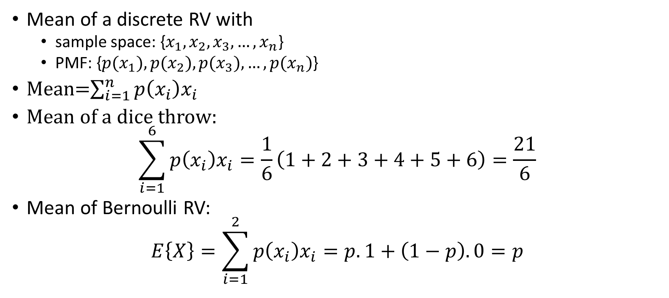
Mean of Discrete RV
Mean of a discrete RV with
  sample space: {$x_{1},x_{2},x_{3},…,x_{n}$}
  PMF: {${p(x}_{1}),{p(x}_{2}),{p(x}_{3}),…,{p(x}_{n})$}
Mean=$\sum_{i=1}^{n}{p\left(x_{i}\right)x_{i}}$
Mean of a dice throw:
$$\sum_{i=1}^{6}{p\left(x_{i}\right)x_{i}}=\frac{1}{6}\left(1+2+3+4+5+6\right)=\frac{21}{6}$$
Mean of Bernoulli RV:
$$E\left\{X\right\}=\sum_{i=1}^{2}{p\left(x_{i}\right)x_{i}}=p.1+\left(1−p\right).0=p$$

Slide 23

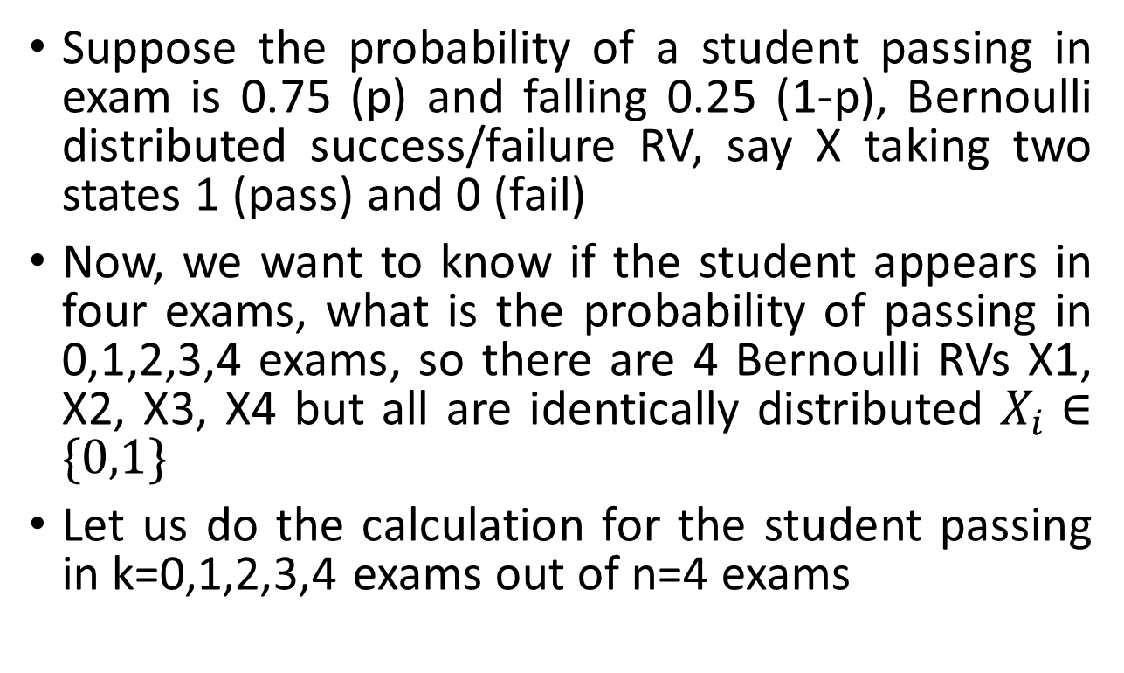
Binomial Distribution
Suppose the probability of a student passing in exam is 0.75 (p) and falling 0.25 (1-p), Bernoulli distributed success/failure RV, say X taking two states 1 (pass) and 0 (fail)
Now, we want to know if the student appears in four exams, what is the probability of passing in 0,1,2,3,4 exams, so there are 4 Bernoulli RVs X1, X2, X3, X4 but all are identically distributed $X_{i}∈\{0,1\}$
Let us do the calculation for the student passing in k=0,1,2,3,4 exams out of n=4 exams
Let us define a new RV, Y; P(Y=k) means the probability of passing in k exams

Slide 24
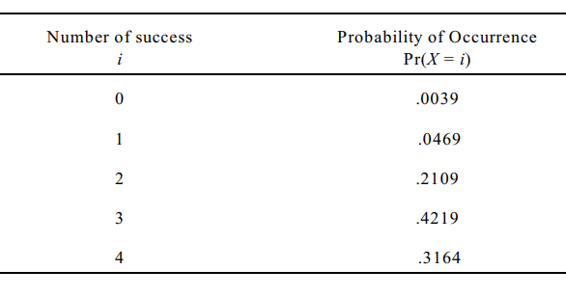
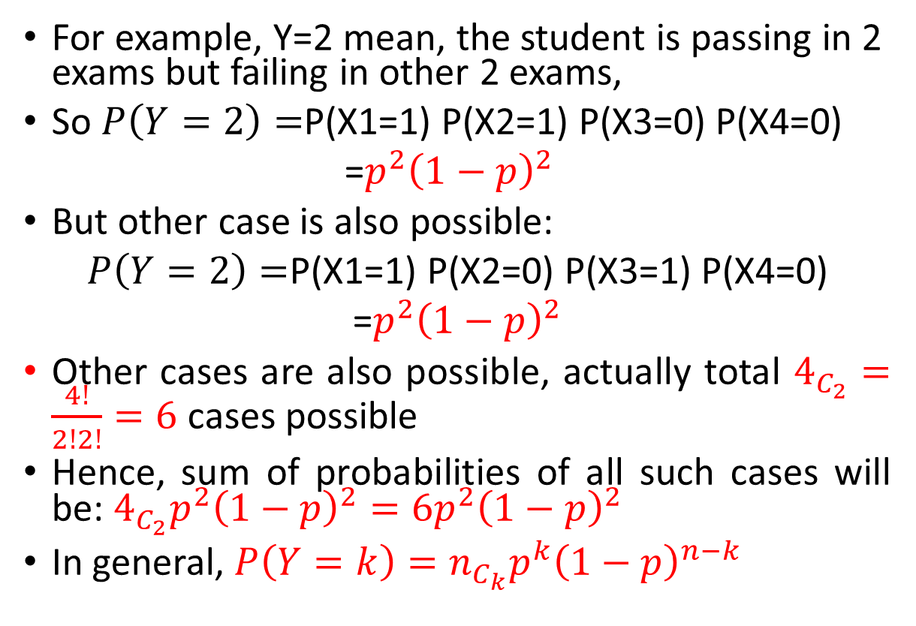


Example cont…
For example, Y=2 mean, the student is passing in 2 exams but failing in other 2 exams,
So $P\left(Y=2\right)=$P(X1=1) P(X2=1) P(X3=0) P(X4=0)
=$p^{2}{\left(1−p\right)}^{2}$
But other case is also possible:
$P\left(Y=2\right)=$P(X1=1) P(X2=0) P(X3=1) P(X4=0)
=$p^{2}{\left(1−p\right)}^{2}$
Other cases are also possible, actually total $4_{C_{2}}=\frac{4!}{2!2!}=6$cases possible
Hence, sum of probabilities of all such cases will be: $4_{C_{2}}p^{2}{\left(1−p\right)}^{2}=6p^{2}{\left(1−p\right)}^{2}$
In general, ${P\left(Y=k\right)=n}_{C_{k}}p^{k}{\left(1−p\right)}^{n−k}$
$n_{C_{k}}$=$\frac{n!}{k!(n−k)!}$
$$n!=n.\left(n−1\right).\left(n−2\right)….3.2.1$$

Slide 25
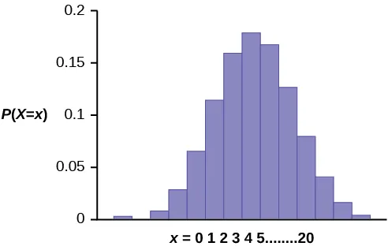
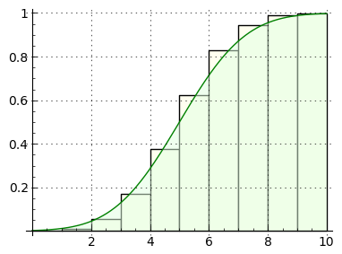

Binomial Distribution
PMF:
$${P\left(x=k\right)=n}_{C_{k}}p^{k}{\left(1−p\right)}^{n−k}$$
CDF:
$$P\left(x≤k\right)=\sum_{k=0}^{n}{n_{C_{k}}p^{k}{\left(1−p\right)}^{n−k}}$$
Mean: np

Slide 26
Continuous Random Variables

Slide 27
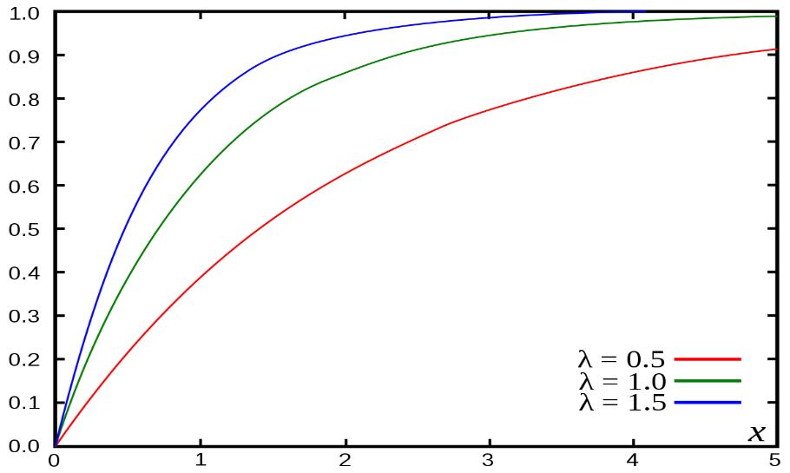
Continuous Random Variables
Cumulative Distribution function
Discrete RV
Continuous RV

Slide 28
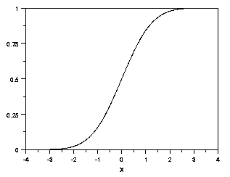


Continuous Random Variables
Cumulative Distribution function:
Properties:

Slide 29
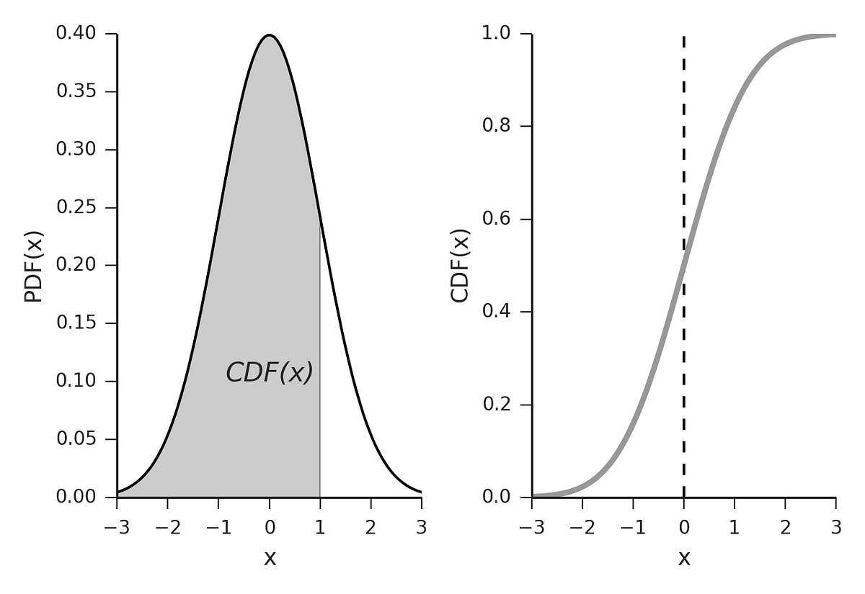

Probability Density Function

Slide 30


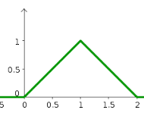
PDF Properties
Is this a valid PDF?
1. Property 1 satisfied
2. Area under curve=(1/2)x2x1=1
VALID PDF

Slide 31

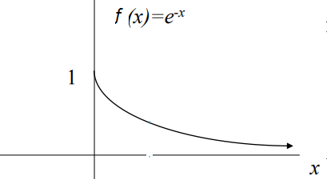
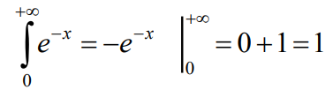
Exponential Distribution
  The negative exponential PDF (in probability, this is called an “exponential distribution”):
  This function integrates to 1:

Slide 32

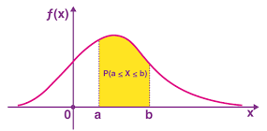
Probability Calculation
From the PDF curve, we can find probability of the RV lying between two values a and b

Slide 33
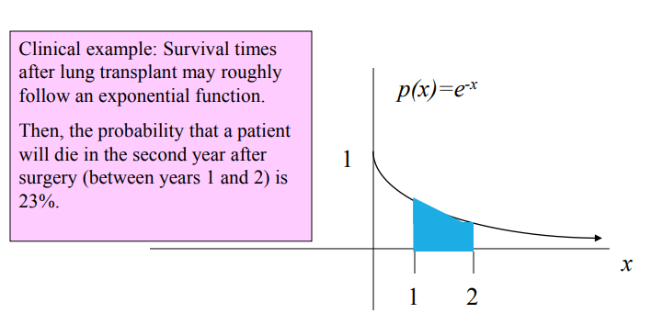
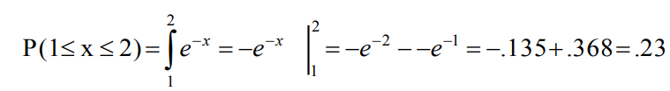
For example, the probability of x falling within 1 to 2:

Slide 34
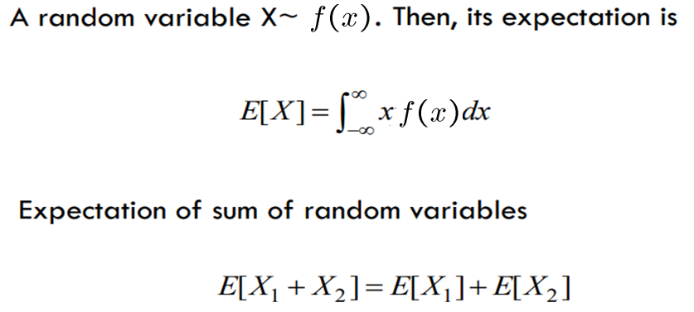
Expectation

Slide 35
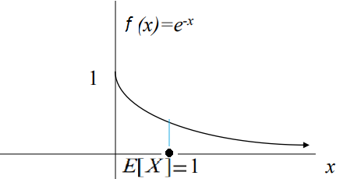
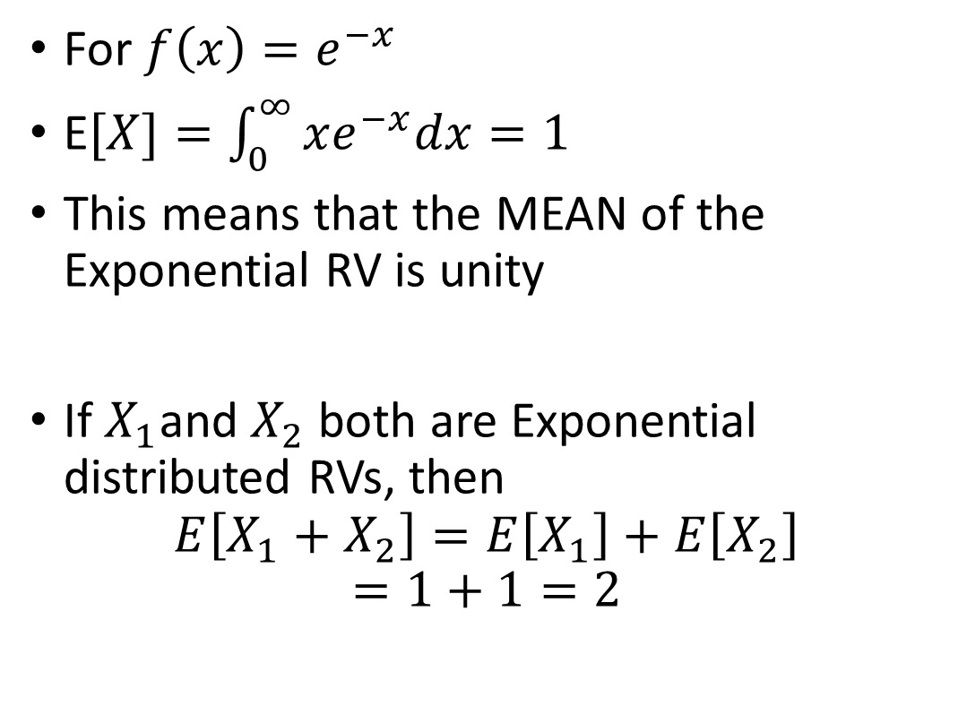
Exponential Distribution
For $f\left(x\right)=e^{−x}$
E$[X]=\int_{0}^{∞}{xe^{−x}dx=1}$
This means that the MEAN of the Exponential RV is unity
If $X_{1}$and $X_{2}$ both are Exponential distributed RVs, then
$$E\left[X_{1}+X_{2}\right]=E\left[X_{1}\right]+E\left[X_{2}\right]$$
$$=1+1=2$$

Slide 36
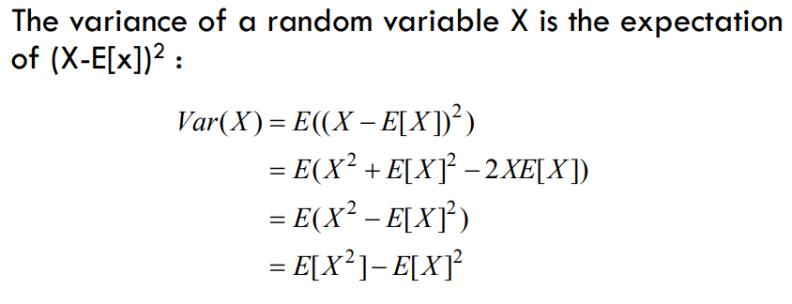
Variance

Slide 37
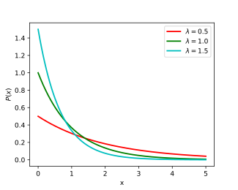
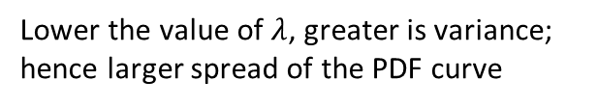
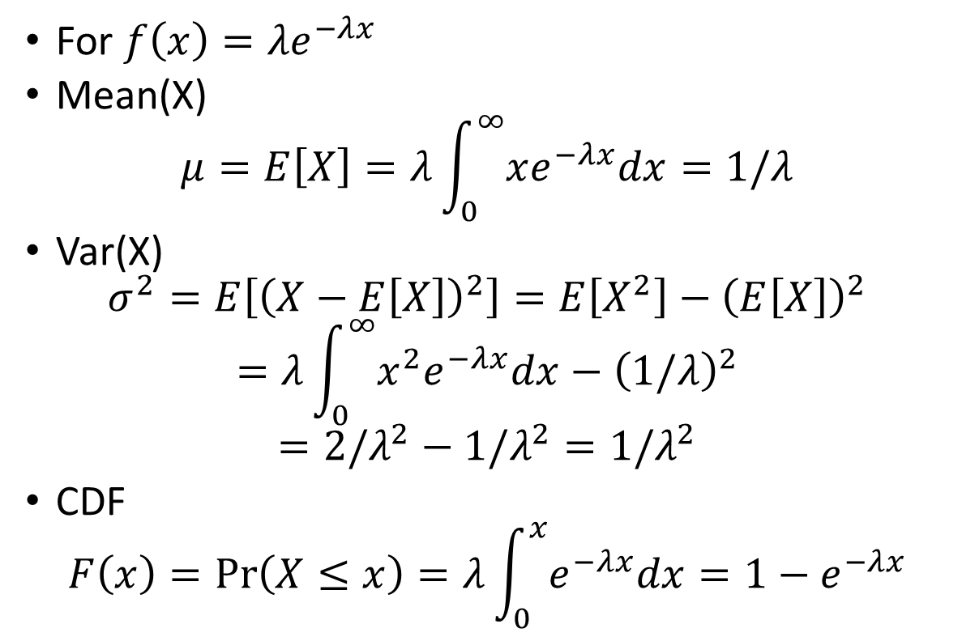
Exponential Distribution
For $f\left(x\right)={λe}^{−λx}$
Mean(X)
$$μ=E\left[X\right]=λ\int_{0}^{∞}{xe^{−λx}dx}=1/λ$$
Var(X)
$$σ^{2}=E\left[{\left(X−E\left[X\right]\right)}^{2}\right]=E\left[X^{2}\right]−{\left(E\left[X\right]\right)}^{2}$$
$$=λ\int_{0}^{∞}{x^{2}e^{−λx}dx−{\left(1/λ\right)}^{2}}$$
$$=2/λ^{2}−1/λ^{2}=1/λ^{2}$$
CDF
$$F\left(x\right)=\operatorname{Pr}\left(X≤x\right)=λ\int_{0}^{x}{e^{−λx}dx}=1−e^{−λx}$$
Lower the value of $λ$, greater is variance;
hence larger spread of the PDF curve

Slide 38
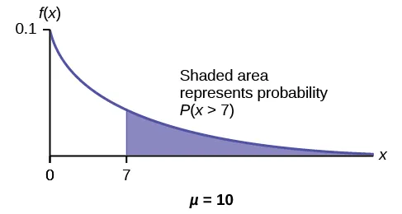
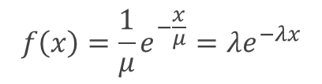

Applications in ML
On the average, a certain computer part lasts ten years. The length of time the computer part lasts is exponentially distributed.
What is the probability that a computer part lasts more than 7 years?
$$f\left(x\right)=\frac{1}{μ}e^{−\frac{x}{μ}}=λe^{−λx}$$
F$\left(x\right)=\int_{0}^{x}{\frac{1}{μ}e^{−\frac{x}{μ}}dx}=1−e^{−\frac{x}{μ}}$

Slide 39

Let x = the amount of time (in years) a computer part lasts.
$λ=\frac{1}{μ}=\frac{1}{10}=0.1$: $f\left(x\right)=λe^{−λx};F\left(x\right)=1−e^{−λx}$
P(x > 7) = 1 – P(x < 7).
Since P(X < x)= $F\left(x\right)$= $1−e^{−λx}$
then P(X > x) = 1 – ($1−e^{−λx}$) = $e^{−λx}$
P(x > 7) = e^{(–0.1)(7)} = 0.4966.
The probability that a computer part lasts more than seven years is 0.4966.

Slide 40

Uniform Distribution

Slide 41

Example: Uniform Distribution

Slide 42

Uniform Distribution: General Case

Slide 43

Mean and Variance for the Uniform Distribution

Slide 44



NORMAL DISTRIBUTION
Mean: $μ$
Variance: $σ^{2}$
SD: $σ$

Slide 45



Slide 46

THE NORMAL DISTRIBUTION: AS MATHEMATICAL FUNCTION (PDF)

Slide 47


NORMAL DISTRIBUTION IS DEFINED BY ITS MEAN AND STANDARD DEV.
$$E\left[X^{2}\right]−μ^{2}=$$

Slide 48

UNDERSTANDING MEAN & STANDARD DEVIATION

Slide 49

UNDERSTANDING MEAN & STANDARD DEVIATION

Slide 50



Tail Probability
$$Q\left(\frac{x−μ}{σ}\right)=\operatorname{Pr}\left(X≥x\right)=\frac{1}{σ\sqrt{2 π}}\int_{x}^{∞}{e^{−\frac{{(x−μ)}^{2}}{2σ^{2}}}dx}$$
$$=\operatorname{Pr}\left(X≥x\right)=\int_{x}^{∞}{f\left(x\right)dx}$$

Slide 51

Standardizing a Normal Distribution
To standardize any normal distribution, we need to transform it so that the mean is 0 and the variance and standard deviation are 1
We can transform any Normal Distribution into a Standard Normal Distribution using the transformation shown above
Convenient to use because of a table of known values for its tail probability (1-CDF), called the Z-score table, or simply the Z-table

Slide 52




Standardizing a Normal Distribution
$$f\left(x\right)=\frac{1}{σ\sqrt{2π}}e^{−{\left(x−μ\right)}^{2}/2σ^{2}}$$
$$f\left(z\right)=\frac{1}{\sqrt{2π}}e^{−z^{2}/2}$$

Slide 53


Z-score Table
Z-Value=$\operatorname{Pr}\left(Z≥z\right)=\frac{1}{\sqrt{2π}}\int_{z}^{∞}{e^{−z^{2}/2}dz}$

Slide 54

Example: Standardized Normal Distribution
Perfume bottles are filled with the average volume of 150 cc and the standard deviation of 2 cc. What percent of bottles will have the volume more than or equal to 152 cc?

Slide 55


Example: Standardized Normal Distribution
Perfume bottles are filled with the average volume of 150 cc and the standard deviation of 2 cc. What percent of bottles will have the volume more than or equal to 152 cc?
$$μ = 150 cc$$
$$σ = 2 cc$$
$$z =\frac{\left(x − μ\right)}{σ} =\frac{152 – 150}{2}= 1$$
From Z-score Table
$$P(x≥152)= 0.15866$$

Slide 56



Correlation matrix $P$
  The correlation matrix $P$ (= upper case Greek “rho”) is the standardized covariance matrix
  $Σ=\left[\begin{matrix}σ_{11} & σ_{12} & σ_{13} \\ σ_{21} & σ_{22} & σ_{23} \\ σ_{31} & σ_{32} & σ_{33}\end{matrix}\right]$
  P$=\left[\begin{matrix}\frac{σ_{11}}{\sqrt{σ_{11}σ_{11}}} & \frac{σ_{12}}{\sqrt{σ_{11}σ_{22}}} & \frac{σ_{13}}{\sqrt{σ_{11}σ_{33}}} \\ \frac{σ_{21}}{\sqrt{σ_{22}σ_{11}}} & \frac{σ_{22}}{\sqrt{σ_{22}σ_{22}}} & \frac{σ_{23}}{\sqrt{σ_{22}σ_{33}}} \\ \frac{σ_{31}}{\sqrt{σ_{33}σ_{11}}} & \frac{σ_{32}}{\sqrt{σ_{33}σ_{22}}} & \frac{σ_{33}}{\sqrt{σ_{33}σ_{33}}}\end{matrix}\right]$
  Where $P$ is a symmetric matrix

Slide 57


Correlation: Observations

Slide 58


Correlation Calculations
Formula:
$\left[x_{1},x_{2},…,x_{n}\right]$ and $\left[y_{1},y_{2},…,y_{n}\right]$ are two vectors

Slide 59



Slide 60



Slide 61



Central Limit Theorem
Let $X_{1},X_{2},X_{3},…,X_{n}$ are the random samples drawn from a population with overall mean $μ$ and variance $σ^{2}$, then we have the following asymptotic results:
$$Z={Lim}_{n→∞}\left(\frac{{\overline{X}}_{n}−μ}{σ/√n}\right)∼N(0,1)$$
$${\overline{X}}_{n}=\frac{X_{1}+X_{2}+…+X_{n}}{n}$$
SRS—simple random sample

